Slide 1
Squirrel Feeding 101
Willy Teav

Slide 2
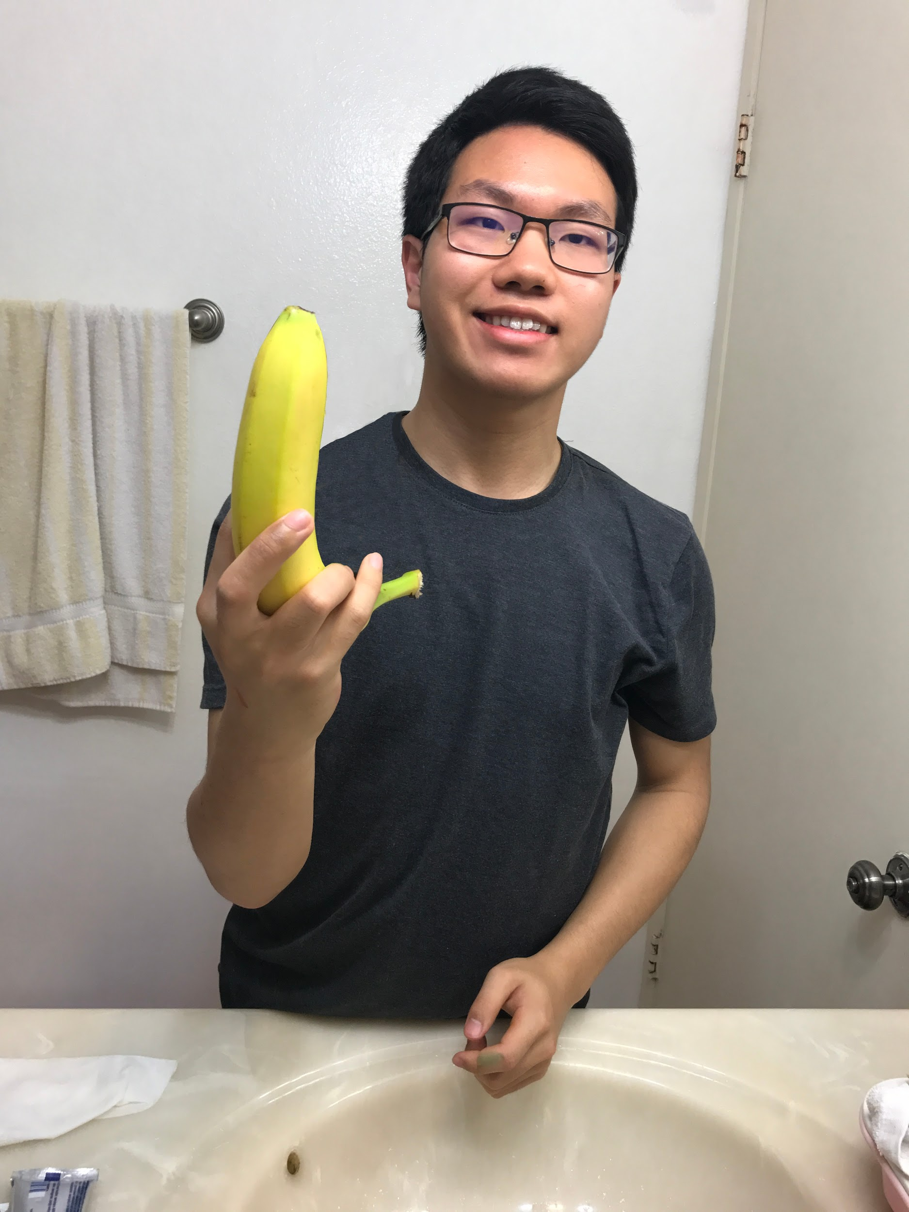
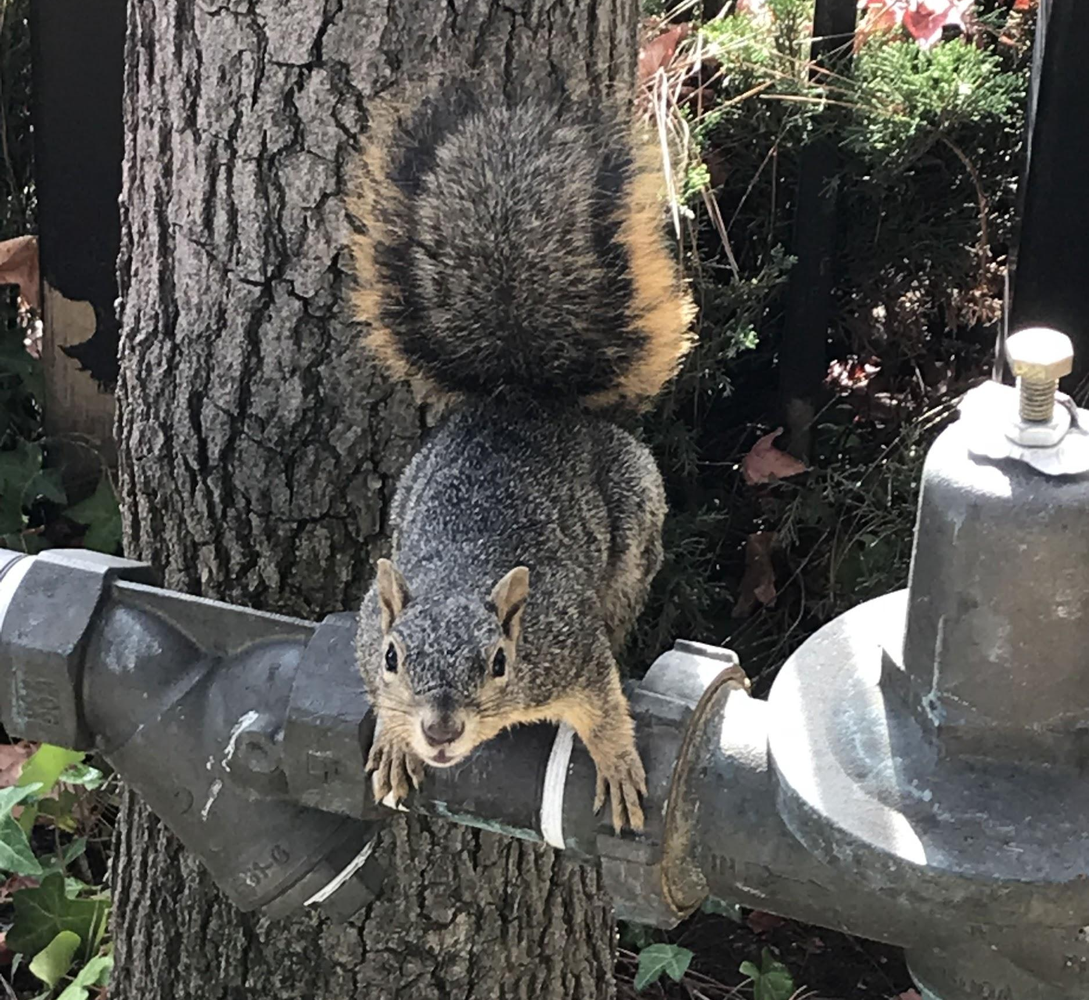
About Me
From San Jose, CA
Freshman @ UCLA
Aerospace Engineering Major
Likes Squirrels

Slide 3
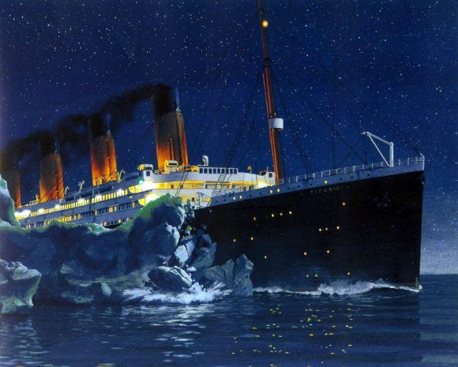
Ice-Breaker!

Slide 4
Agenda (hopefully if things go according to plan, like no rain)
I lecture for the first half of class
Students go outside and feed squirrels for the last half of class

Slide 5
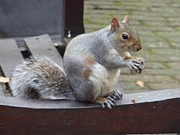
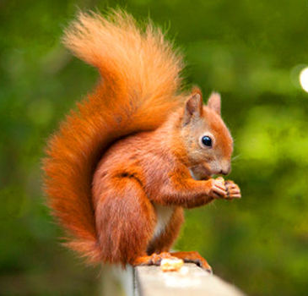
About Squirrels:
The most prevalent squirrel species in this area (campus) is the Fox Squirrel
Other squirrels: Eastern Grey and Red Squirrel

Slide 6
About Fox Squirrels:
Quick Facts:
Largest North American Tree Squirrel
Found throughout America
Day creatures (diurnal)
Lives for an average of 14 years

Slide 7
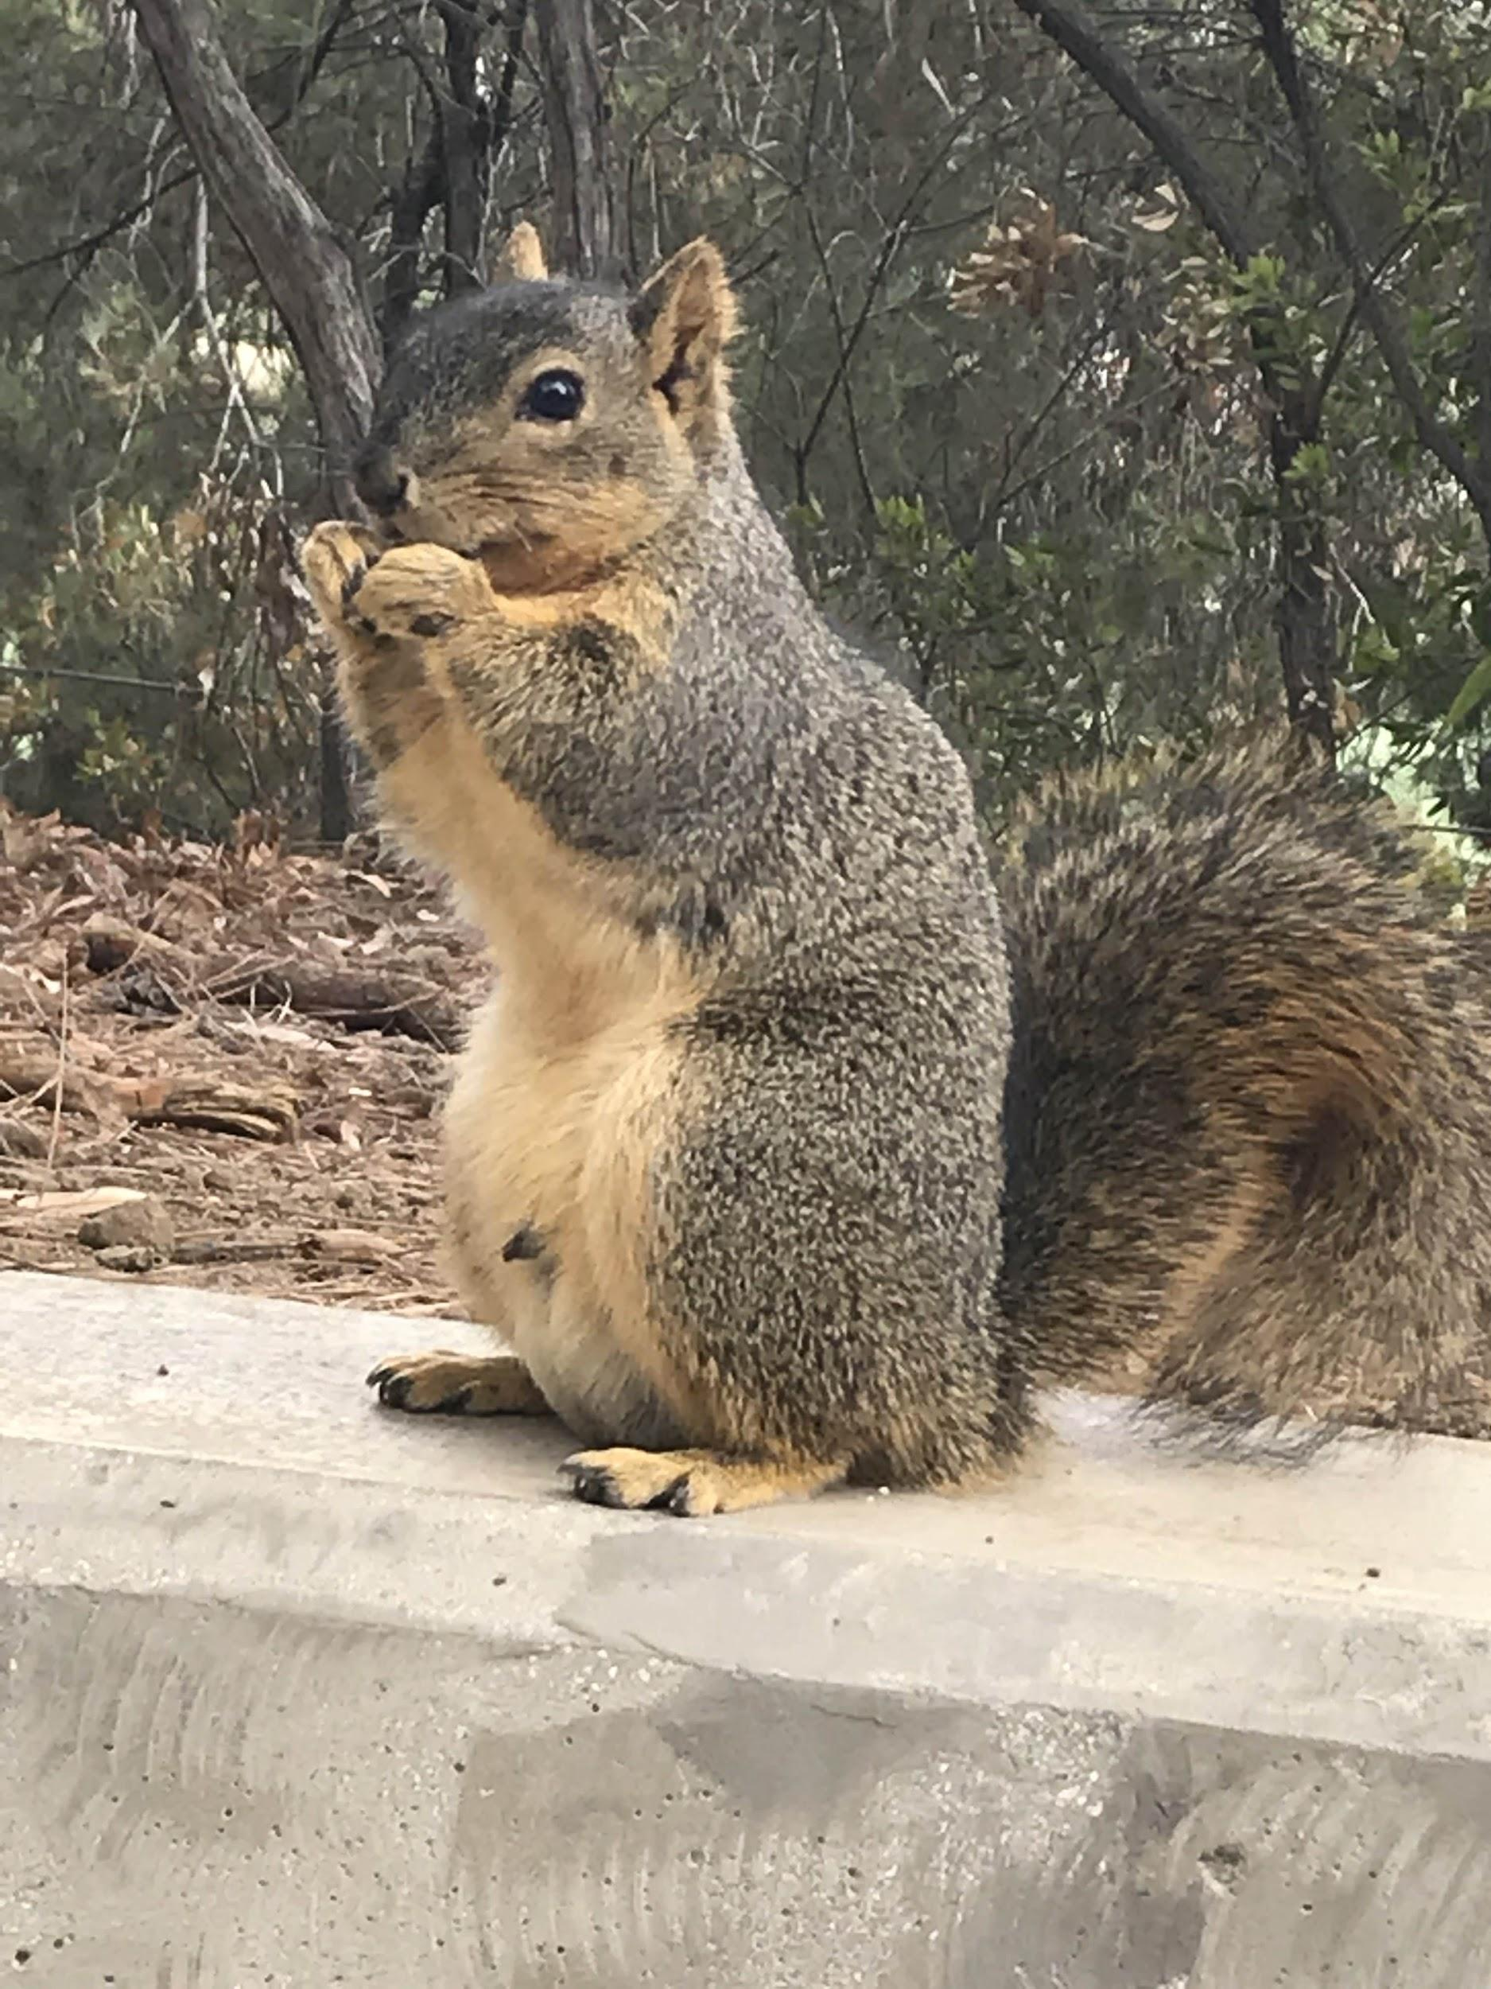
Physical Characteristics:
Bushy Tail
Red-Orange/Brownish Color
Double Jointed Ankles
Sharp claws

Slide 8
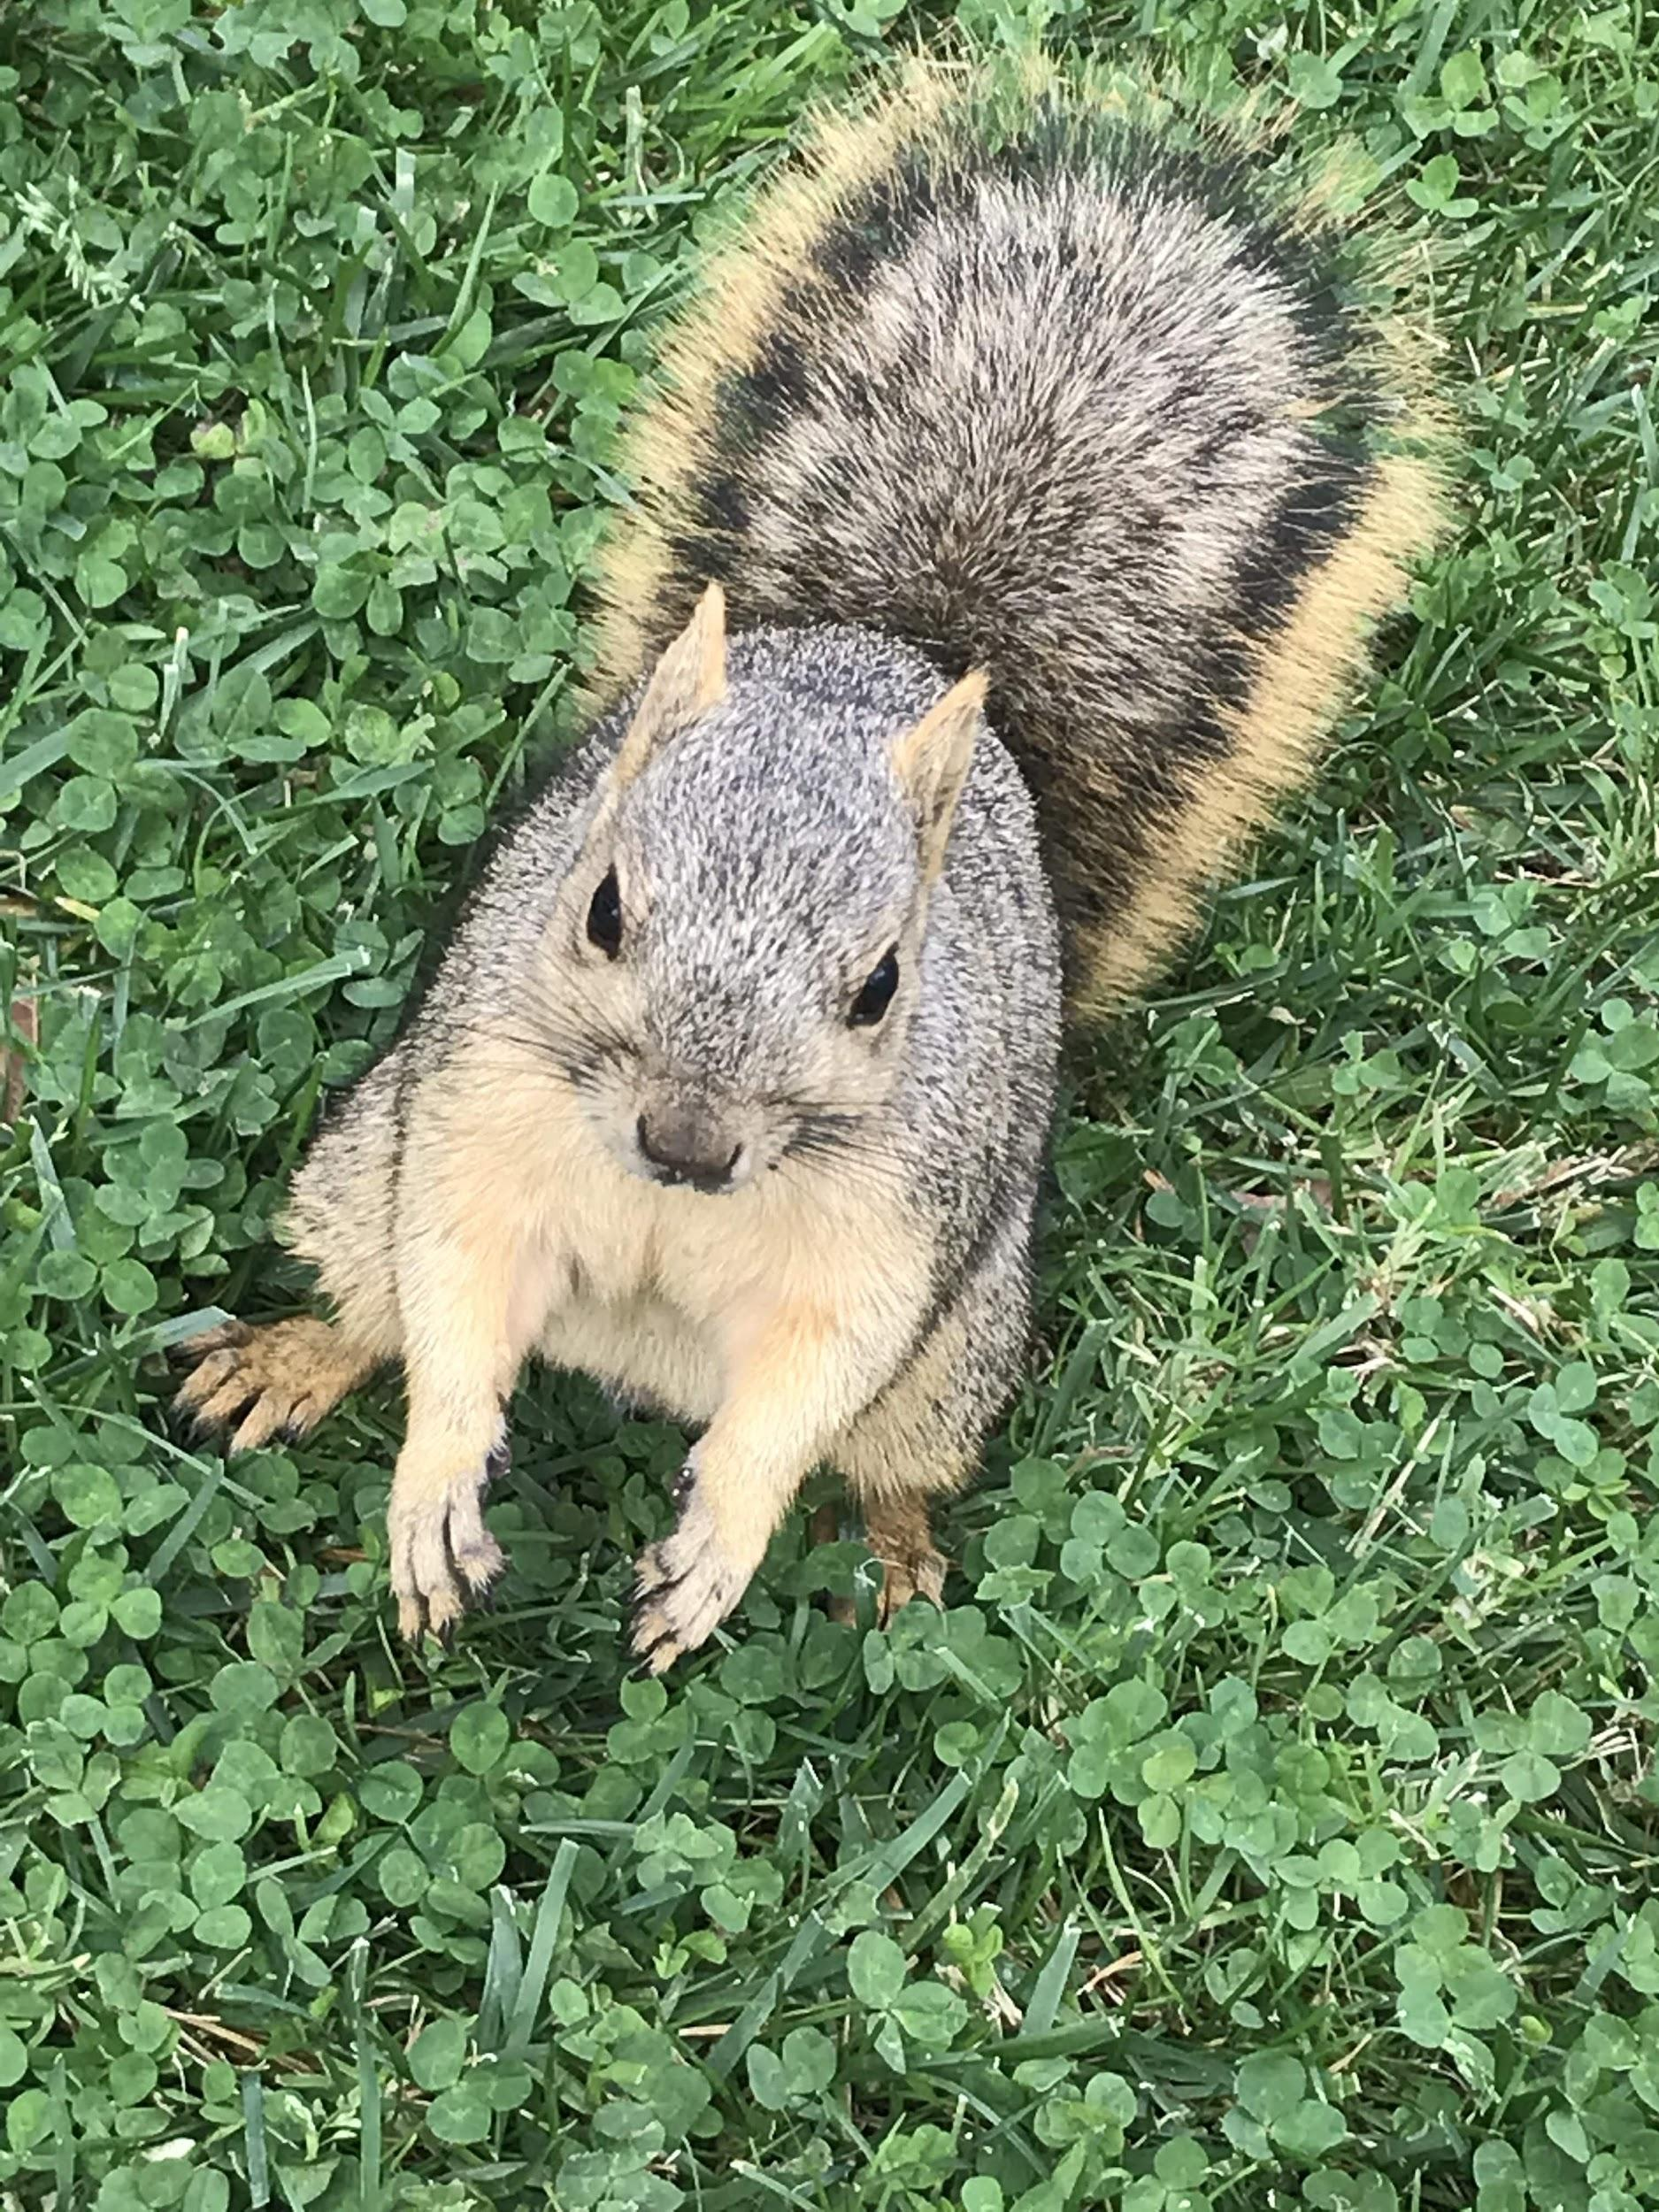
Ethology
Barking/Chirping
Tail Signals
Chasing each other
December - February = Mating Season
Notes:
Communication, danger, acknowledging presence/dangers, territory, play fighting, or rape

Slide 9
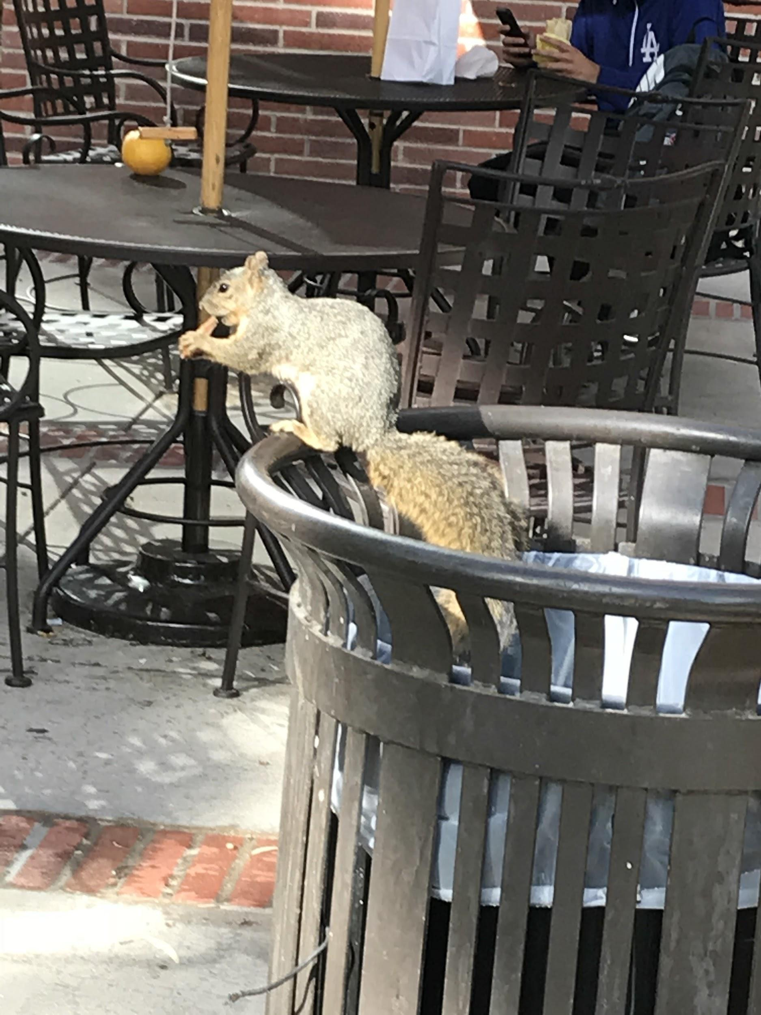
Risks
Squirrels are wild animals
They don’t know English
They might be dirty
Squirrel bites
Actually pretty rare
Rabies are even rarer
Still take shots just in case/see a doctor

Slide 10
What to Feed:
Squirrels aren’t picky
Please avoid poisons
They love nuts
Apparently raw peanuts can be poisonous to squirrels
Things I’ve had success with:
Grapes
Pistachios
Oyster Crackers (v. good because easy to steal from dining halls)
Bread
Bananas
Pizza Crust
Apples
Tortillas

Slide 11
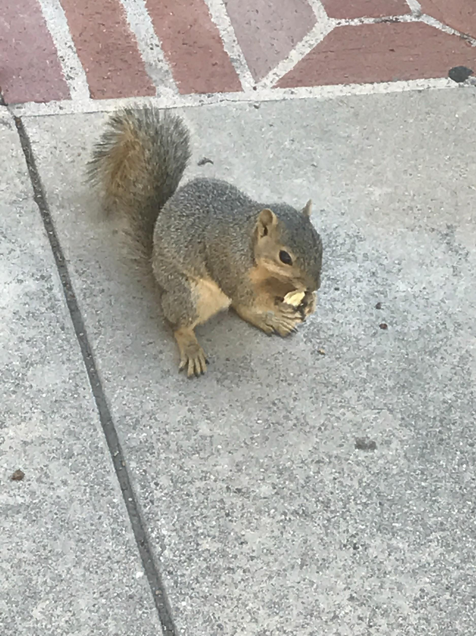
How to Feed:
Don’t scare the squirrel
Try not to make eye contact
Approach cautiously
Throw food in squirrel’s line of vision
Get its attention
Don’t hand feed in a way may get you bitten

Slide 12
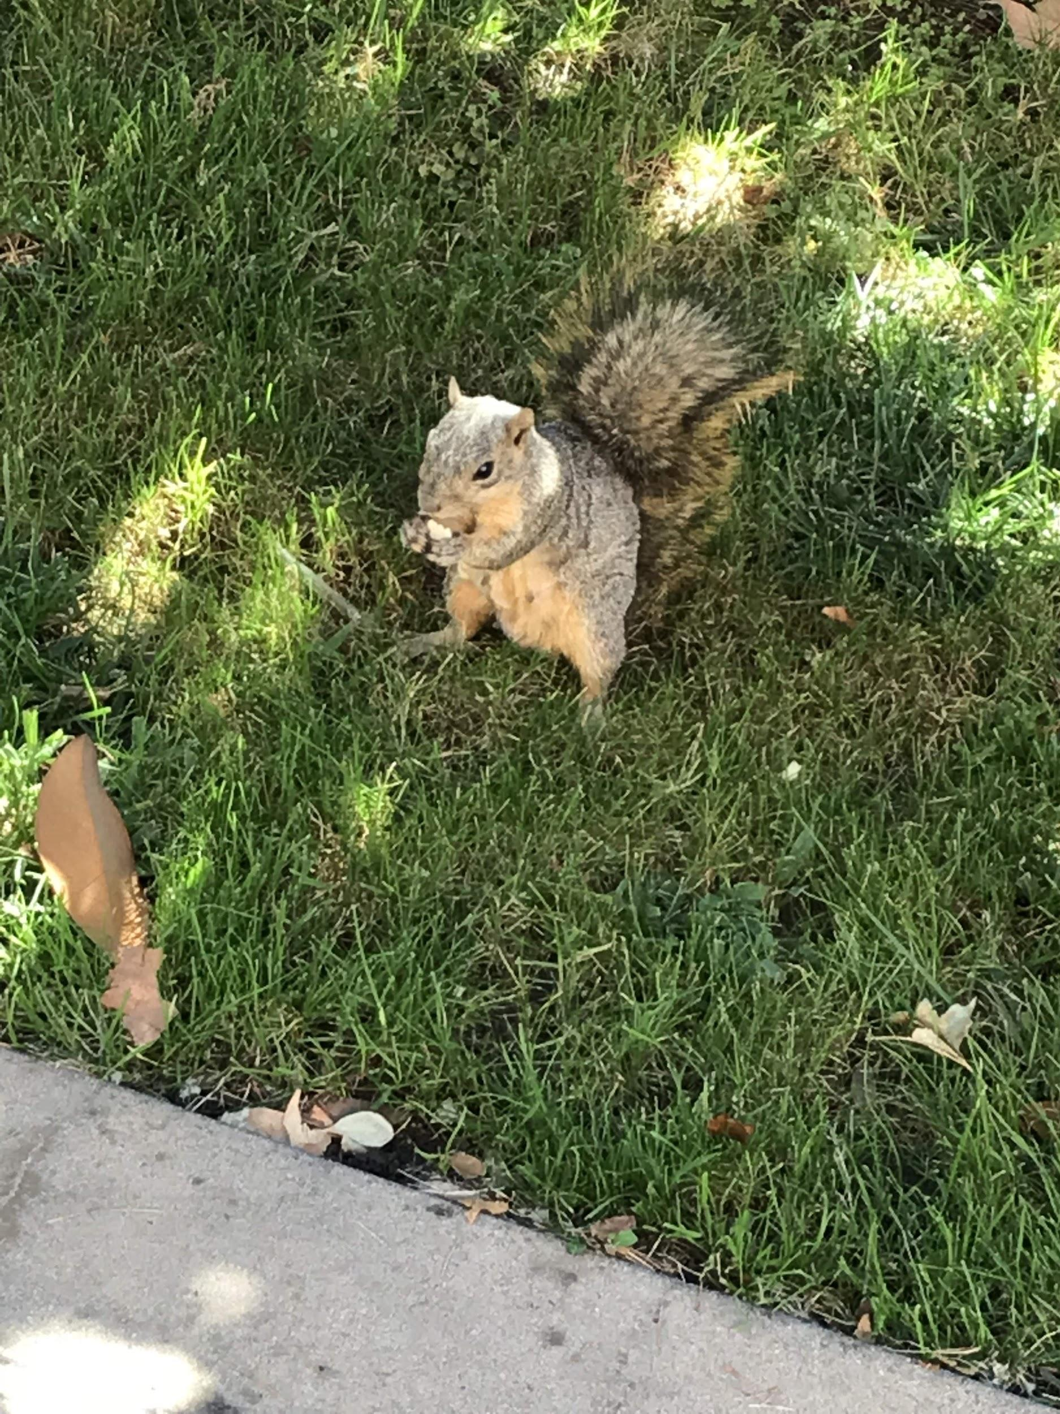
Now Go Outside!

